Slide 1

June 30, 2023
Rocky Mountain Alternate Education

Slide 2





Rocky Mountain Alternate Education and Online Learning serves students who benefit from an alternative learning environment and programming in the communities of Golden, Invermere and Kimberley.
We are proud to share our School Success Plan for the 2023-2024 school year, which was developed with ongoing collaboration with school staff and our school community through the May 2023 Community Engagement session. It is our collective work and the relationships built with community partners that allows us to provide flexible programming to meet the needs of our learners.
Lisa Tenta, Principal

Slide 3
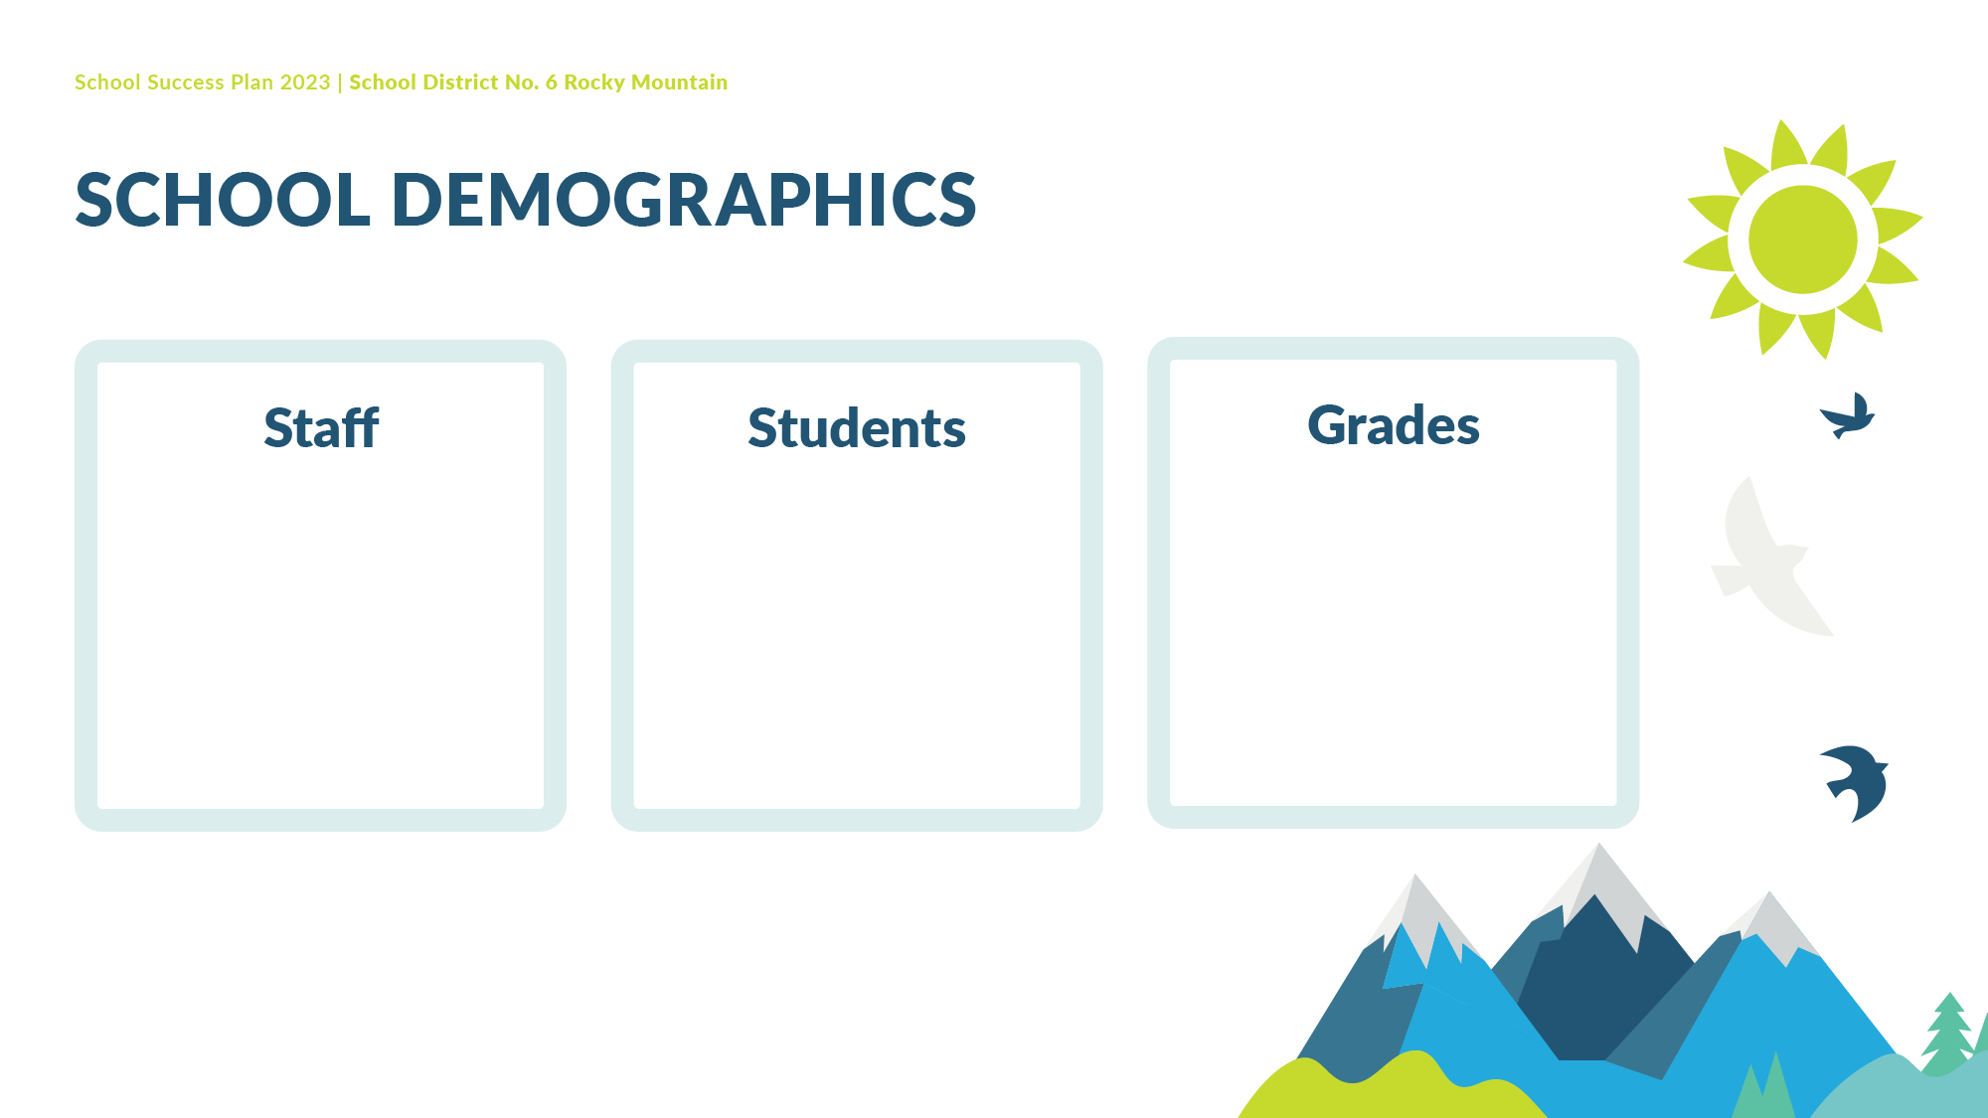
16
Alternate Education Sites
70 students
Online Learning
Learn at Home (K-9): 18 students
Grades 10-12: 150 students
Alternate Education Sites
Grades 10 – 12
Online Learning
Learn at Home: K-9
Grades 10-12
Limitless Potential

Slide 4

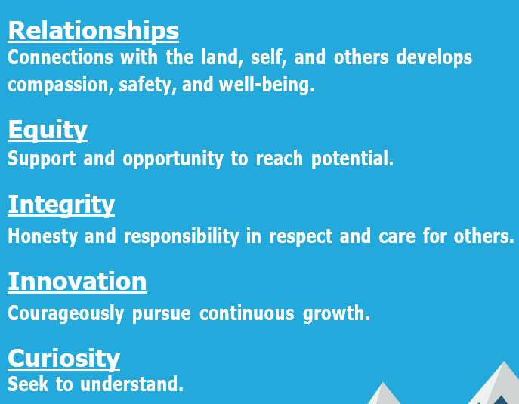
Together as an inclusive community, we nurture curious, connected and adaptable learners
Limitless Potential

Slide 5

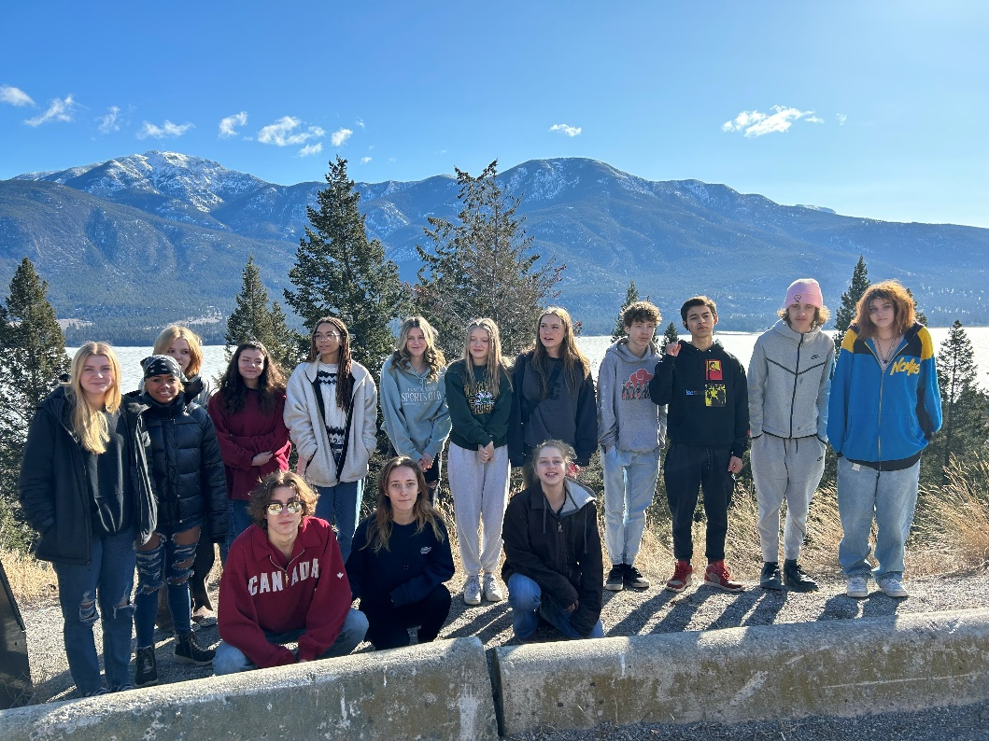

<Insert Image>
Equity and Inclusion
To increase student engagement
<Insert Image>

Slide 6
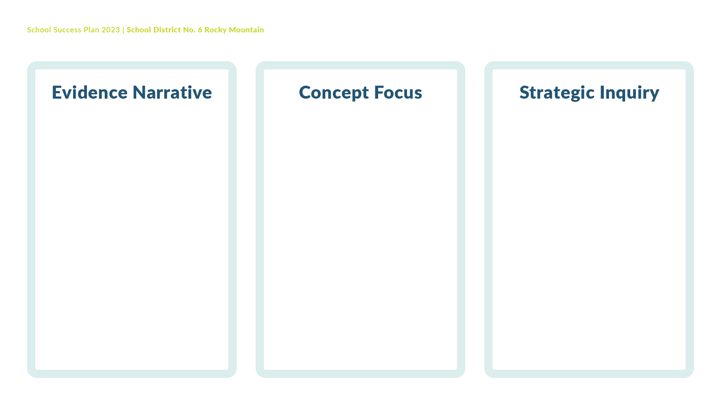
Regular school attendance is a powerful predictor of student outcomes. Attendance records indicate that a significant amount of students attending alternate sites in the Windermere and Golden Zones are attending school less than 50% of the time. This aligns with end of the year report cards that indicate that a significant percentage of Grade 10 and 11 students are not on track for a 5-year Dogwood.
Sense of Belonging – Wellbeing
Circle of Courage Framework
To what extent will the weekly teaching of social emotional strategies improve student attendance, academic engagement and on-track graduation rates?

Slide 7

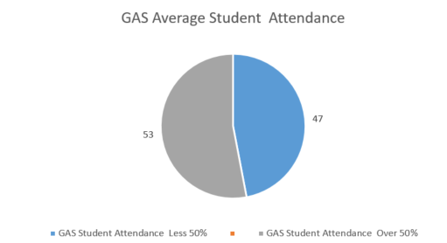
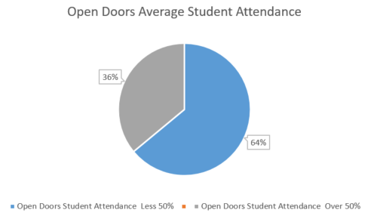
The above data indicates that on average 59% of Alternate Education students are attending school more than 50% of the time.
On Track to meet the 5 Year Dogwood Graduation Requirements
 | Percent on Track | Not on Track
Grade 10 | 11% | 89%
Grade 11 | 42% | 58%
2023 Alternate School Graduates
5 Year Dogwood | 50%
6 Year Dogwood | 4%
5 Year Adult Dogwood | 21%
6 Year Adult Dogwood | 25%

Slide 8
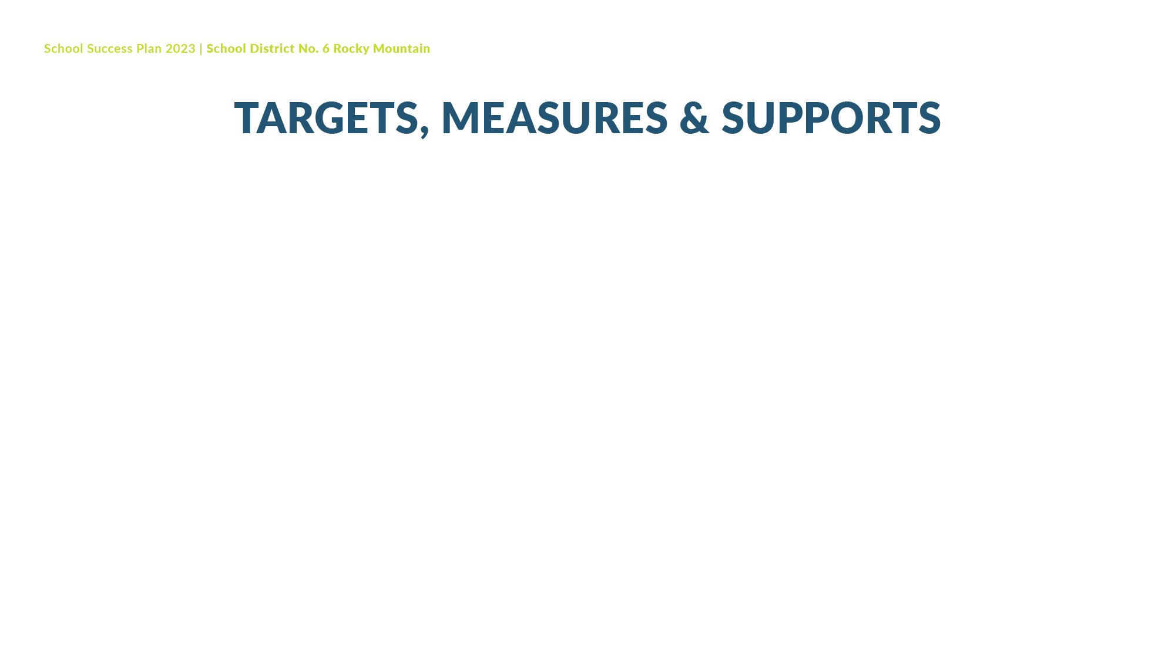
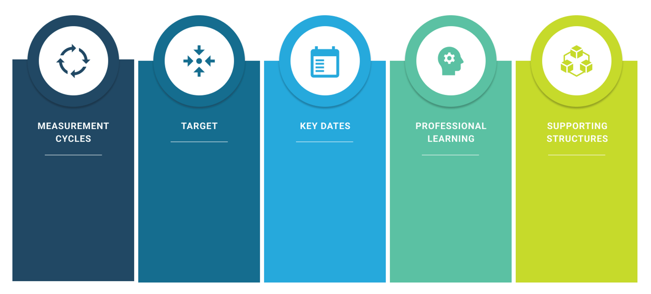
75% attendance at all sites
Term 3 Report Data will indicate that 100% of students are on track with their Individual Learning Plan goals
Quarterly Report Card review meetings
Monthly attendance review at staff meetings
Learning to Breathe: Mindfulness Curriculum for Adolescents
Circle of Courage
Trauma Informed Practice
Monthly staff meetings
Diploma Verifications reviewed by parents
Student Learning Plan Meetings
Collaboration with District VP Learning Services
Universal attendance tracking system
School Counselor on site – weekly
Outside Agencies
Weekly attendance tracking
Quarterly Graduation Requirement tracking

Slide 9
The option to take an online course amongst students in Grades 10-12 has become more prevalent. Term three report card data indicates that a significant percentage of students enrolled in courses with RMOL are less than 50% completed by April. Many of these students have enrolled in courses in September.
Increased engagement in the final 2 months is a notable trend, but this is often accompanied with increased levels of student stress and, in some cases, suboptimal effort or results.
Improved communication and course completions
(Parents, Students and Bricks and Mortar schools)
Will improved communication with parents, students and Bricks and Mortar schools result in improved student engagement in their online courses and decrease course withdrawal rates?

Slide 11
Formal Reporting Cycle:
Term 1
Term 2
Term 3
Term 4
Collaboration: Secondary school teams, weekly RMOL team
D2L Brightspace Community
District Learning Services support
Monthly
Student Survey: 2x/year
30% Grade 10-12
Course completion rate by term 3
D2L Brightspace ongoing training
(Intelligent Agents)

Slide 12

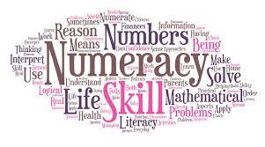

<Insert Image>
Nurture the potential of each student
To increase student performance in numeracy and literacy
<Insert Image>

Slide 13
Graduation Numeracy and Literacy 10 Assessments indicate that students need further practice with analyzing and justifying responses
Critical Thinking and Problem Solving
Depth of Knowledge
Will a focus on teaching strategies for Critical Thinking and Problem-Solving increase student achievement on the Graduation Numeracy and Literacy 10 Assessments?

Slide 14
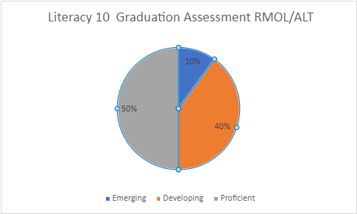
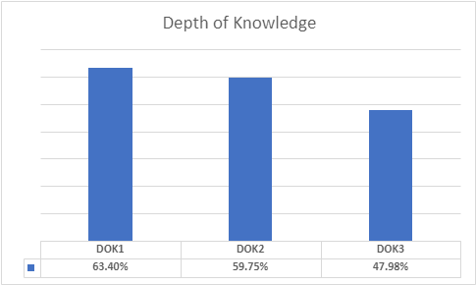
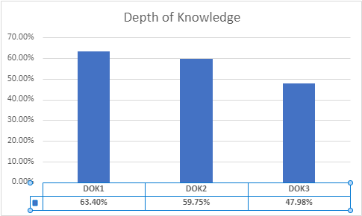
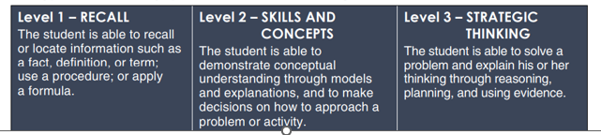
Literacy 10 Graduation Assessment

Slide 15
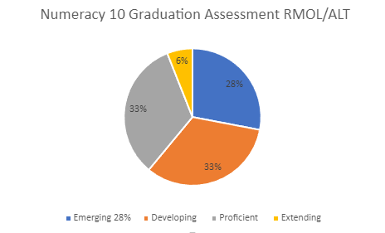
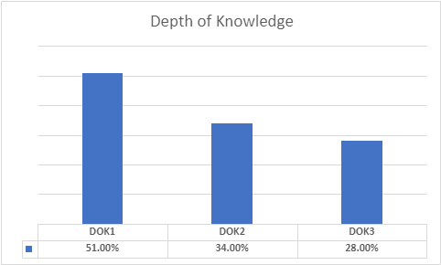
Numeracy 10 Graduation Assessment

Slide 16
10% increase of students demonstrate Proficiency (GNA & GLA 10)
10% increase noted in Depth of Knowledge response completions
Fall Assessment
Fall Data Review
Winter Assessment
Winter Data Review
Spring Assessment
Spring Data Review
October 2023
January 2024
April 2024
June 2024
Review of GNA & GLA 10 tasks
Real-Life Task development
Supports for students requiring accommodations
Collaboration with:
All alternate school sites
Community agencies
District Principal Literacy & VP Numeracy
District Learning Services

Slide 17


<Insert Image>
Growing the capacity of self and others
To build staff capacity and knowledge with Mental Health Literacy

Slide 18
Survey results indicate that 50% of staff have worked in an alternative school setting for less than 5 years. To strengthen our capacity, staff have been working together to define the student intake process, share resources, and identify areas where additional student support is needed. Providing additional support to address the mental health needs of our students is on the forefront of discussions; this will be the focus of our collaborative work in the upcoming school year.
Mental Health Literacy
If all staff build a common understanding of and practice Mental Health Literacy, how will this impact student access to supports and sense of belonging?

Slide 19
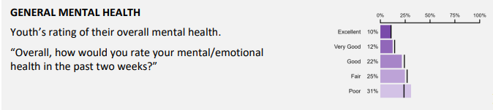
SD6 Student Learning Survey Grade 10 Results – 2023
SD6 Youth Development Survey - 2023
Due to enrollment numbers, data specific to each Alternate School was not available. This will be addressed in the upcoming school year with the implementation of a school-based survey.

Slide 20
100% of staff complete Mental Health Literacy Training
100% of students to report that they are learning to care for their mental health at school most of the time
Monthly staff meetings at each site
Quarterly Team Meetings
Fall and Spring staff survey
Monthly Check-In
Spring Survey
UBC Mental Health Literacy Training
Circle of Courage Framework
Book Club – Feeling Seen
Collaboration: Community Agencies, District Learning
School Counsellor
Services, and Staff Team

Slide 21

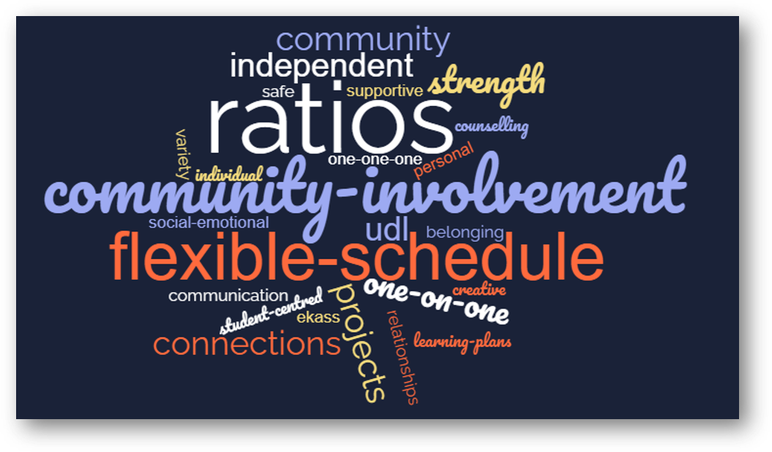
Stewardship for the future
To increase opportunities for place-based learning experiences and community connections

Slide 22
One of the First Peoples Principles of Learning states that, “Learning is holistic, reflexive, reflective, experiential, and relational (focused on connectedness, on reciprocal relationships, and a sense of place)”. Staff are motivated to enhance our programming and will provide increased learning opportunities within the community. This will allow students to make connections and build interpersonal relationships in their community, resulting in a strengthened sense of belonging.
Connections to community
and land-based experiences
Will programming anchored in place-based learning increase student overall sense of belonging and achievement?

Slide 23
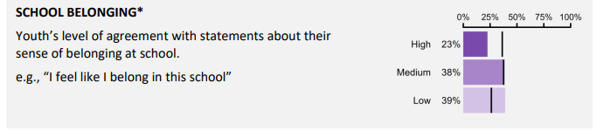
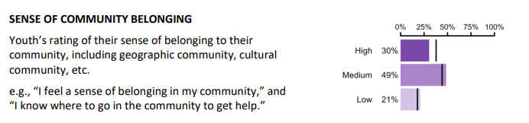
SD6 Student Learning Survey Grade 10 Results – 2023
SD6 Youth Development Survey Grade 11- 2023
* Due to enrollment numbers, data specific to each Alternate School was not available. This will be addressed in the upcoming school year with the implementation of a school-developed belonging survey.

Slide 24
Monthly staff meetings at each site
Quarterly Team Meetings
Fall and Spring staff survey
1 community field trip per month
100% of students attend field trips
Monthly Check In
Spring Survey Results review
Development of Sense of Belonging Survey
Book Club – Feeling Seen
Circle of Courage Framework
Engagement with Community Agencies
District VP Learning Services

Slide 25

UBC Mental Health Literacy Training
Circle of Courage Framework
Mind Up for Life Curriculum
Learning to Breathe: Mindfulness Curriculum for Adolescents
Community Agency – Bi-annual Interagency collaboration
Strategic Budgeting – investment in full team collaboration
First Peoples Principles of Learning
Ministry of Education – Graduation Numeracy and Literacy practice tasks
Microsoft Forms – Belonging Survey development
Microsoft Excel – Attendance

